Slide 1

Week # 16
Operations Research
(Software Engineering)

Slide 2
Maximal flow problem
The max flow problem is a classic optimization problem in graph theory that involves finding the maximum amount of flow that can be sent through a network of pipes, channels, or other pathways, subject to capacity constraints. The problem can be used to model a wide variety of real-world situations, such as transportation systems, communication networks, and resource allocation.

Slide 3
In the max flow problem, we have a directed graph with a source node s and a sink node t, and each edge has a capacity that represents the maximum amount of flow that can be sent through it. The goal is to find the maximum amount of flow that can be sent from s to t, while respecting the capacity constraints on the edges.

Slide 4
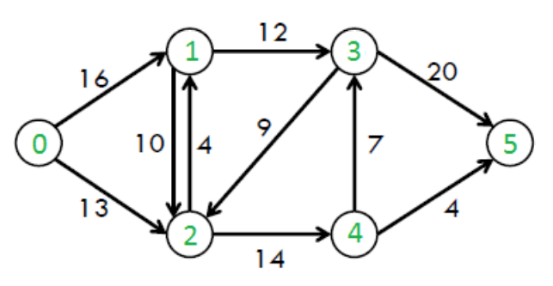
Maximal flow problem

Slide 5
Maximal flow problem
0/
8/
4/
12
0-1-3-5=12

Slide 6
Maximal flow problem
block
8/
4/
12+4
9/
0/
10/
0-1-3-5=12
0-2-4-5=4

Slide 7
Maximal flow problem
block
8/
4/
0/
12+4+7
2/9/
block
3/10/
0-1-3-5=12
0-2-4-5=4
0-2-4-3-5=7

Slide 8
Maximal flow problem
block
8/
4/
block
12
0/
2/9/
block
3/10/
Maximum flow is =12+4+7=23

Slide 9
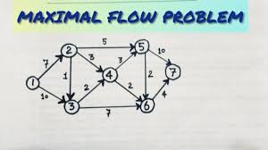
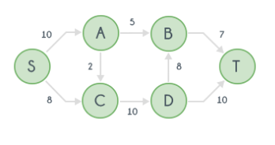

Slide 10
Thank you!

